Slide 1




C# Everywhere with Blazor
Dave Brock
Central Wisconsin IT Conference
October 6, 2018
@daveabrock
daveabrock.com

Slide 2

Hello, I’m Dave
Dave Brock, officially
“Full stack” software engineer in Madison
Focuses on .NET stack
C#
.NET Core
SQL Server
JavaScript/TypeScript
Advocate of <blink> tag from 1995-1999
(#sorrynotsorry)
@daveabrock
daveabrock.com

Slide 3
The web is amazing
We have evolved and can write code against so many devices:
Mobile!
Tablets!
Gaming and consoles!
Embedded devices (like cars)!
What about the browser?
@daveabrock
daveabrock.com

Slide 4




























The browser *is* JavaScript
@daveabrock
daveabrock.com

Slide 5
The choice is yours
@daveabrock
daveabrock.com

Slide 6

Some wisdom about writing for the browser
Any developer can write code in the browser for any language he/she wants,
so long as it’s JavaScript.
Henry Ford, 1909
(paraphrasing)
@daveabrock
daveabrock.com

Slide 7
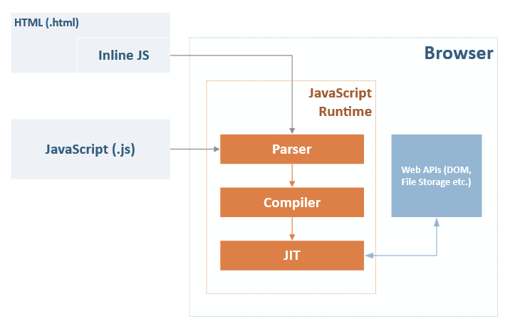
How JavaScript Works (Diagram)
Stolen Borrowed from Dave Glick’s article at https://daveaglick.com/posts/blazor-razor-webassembly-and-mono
@daveabrock
daveabrock.com
Notes:
The code gets parsed, the compiler converts the syntax into bytecode, then a JIT interpreter evaluates on the fly at runtime

Slide 8

What is Web Assembly?
A free and open web standard that provides a compilation target for the web – allowing you to run compiled code in any supported browser at native speeds.
Technical definition: “A binary instruction format for a stack-based virtual machine.”
@daveabrock
daveabrock.com
Notes:
This means you can compile some source code, inject it into the JS runtime, and skip over the parsing and compiling step. Meaning you can compile any source code to a WASM file. Any price you pay at build time helps the you run the application.

Slide 9
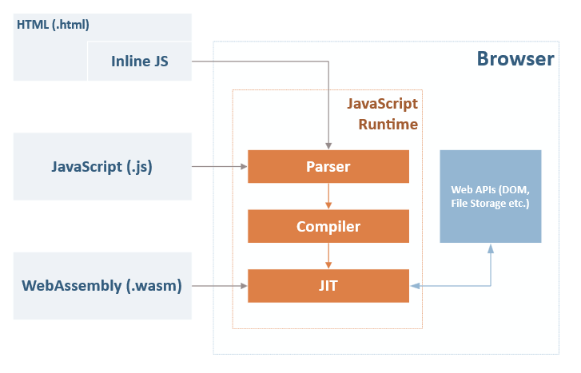
How WebAssembly Works (Diagram)
Stolen Borrowed from Dave Glick’s article at https://daveaglick.com/posts/blazor-razor-webassembly-and-mono
@daveabrock
daveabrock.com
Notes:
WebAssembly code is fed directly into the JIT compiler of the JavaScript runtime. WebAssembly is related to JS with runtime evaluation but isn't itself JavaScript. WebAssembly is not a transpiler like TypeScript, CoffeeScript, etc.
Also, important to note that it isn’t regular assembly code but a bytecode format that can only do what JS does.

Slide 10
Is WebAssembly trying to replace JavaScript?
NO!
From webassembly.org:
“WebAssembly is designed to be a complement to … JavaScript. While WA will over time allow many languages to be compiled to the Web, JavaScript … will remain the single, privileged dynamic language of the web.”
On a practical level, the architecture of WebAssembly does not allow access to web functions like manipulating the DOM or calling browser APIs (like local storage)
@daveabrock
daveabrock.com

Slide 11
Why use .NET in the browser, anyway?
Using .NET in the browser offers:
Wide browser support: runs on open web standards with no plugins and no code transpilation
Leverage existing skills: use your existing .NET skillset to write client-side code
Tooling: Visual Studio and Visual Studio Code offers a first-rate development experience
Modern languages: .NET languages are constantly improving
https://blazor.net/docs/introduction/faq.html
@daveabrock
daveabrock.com
Notes:
Sanderson tried a DotNetAnywhere runtime, but it did not scale well for a framework to run inside the browser.
Mono as a runtime for client platforms and was a natural choice
How do we use C# and markup? Leverage Blazor!
The formula: compile code to IL format and run it – not much different than we’ve been doing for decades.

Slide 12
What is Blazor?
An experimental single-page web app framework built on .NET that runs in the browser with WebAssembly.
https://blazor.net/docs/introduction/faq.html
@daveabrock
daveabrock.com

Slide 13
What is Blazor?
Experimental.
@daveabrock
daveabrock.com

Slide 14
Blazor goals?
Component model
JavaScript interoperability
Rich tooling
Layouts
Live (“hot”) reloading in the browser
Full .NET debugging
Forms and validation
Backward compatibility with asm.js
Publishing and app size trimming
Routing
Server-side rendering
Dependency injection
https://blazor.net/docs/introduction/faq.html
@daveabrock
daveabrock.com

Slide 15

Time for a talk
@daveabrock
daveabrock.com

Slide 16

Why Blazor is different
Unlike plug-ins like Silverlight (or Flash), Blazor is built on open web standards and leverages the advantages of WebAssembly
Because it is built on Web Assembly, it offers:
Near native performance
Safety (it runs in the same sandbox as JS to prevent malicious behavior on the client machine)
Advantages over native JS like high-memory processing and complex multi-threading
@daveabrock
daveabrock.com

Slide 17
How does Blazor work with WebAssembly?
We need a runtime compiled for WA that is aware of .NET.
We use Mono, an open-source and highly-portable .NET runtime. For Blazor, Mono is the only runtime that needs to be compiled to WebAssembly
Mono is used by Xamarin for native client apps on Android, iOS, and macOS, and Unity for game development. Since Blazor is a client-side UI framework, Mono is the natural choice.
Mono is preferred over .NET Core, which is primarily for server applications
@daveabrock
daveabrock.com

Slide 18





How Does Blazor Work with Web Assembly?
BROWSER
.NET WA implementation
(mono.wasm)
Assembly compilation (.dll)
Blazor app
(App.dll)
.cshtml
.NET assemblies
(dependent DLLs)
.cs
@daveabrock
daveabrock.com

Slide 19
Getting started with Blazor
Blazor is now on version 0.6.0, released 10/2/2018
Prerequisites:
.NET Core 2.1 SDK (2.1.402 or later)
Visual Studio 2017 (15.8 or later) with the ASP.NET and web development workload selected
The Blazor Language Services extension from the Visual Studio Marketplace
Installing the Blazor templates from the command line:
dotnet new –i Microsoft.AspNetCore.Blazor.Templates
Details at https://blazor.net/docs/get-started.html
@daveabrock
daveabrock.com

Slide 20

Blazor: Key Concepts – Razor
Razor is a templating engine for creating dynamic web pages in .NET. You can use a combination of Razor syntax and C# code in .cshtml files.
<div>
<h1>@Title</h1>
<button onclick=@DoSomething>Do Something!</button>
</div>
@functions {
public string Title { get; set; }
public Action DoSomething { get; set; }
}
@daveabrock
daveabrock.com

Slide 21
Blazor: Key Concepts – Components
Blazor applications are built with components, which can be viewed of a piece of section of the UI.
Components can then be tested and reused within the application and even between projects!
To Blazor, a component is a class – usually a C# (.cs) or Razor (.cshtml) file.
@daveabrock
daveabrock.com

Slide 22
Blazor: Key Concepts – JavaScript Interop
You will still need JS for browser APIs, DOM manipulation, and access to JS libraries.
Blazor can use any library or API that JavaScript uses.
C# can call into JavaScript code, and JavaScript code can call into C# code.
@daveabrock
daveabrock.com

Slide 23
Blazor: Key Concepts – JavaScript Interop
window.exampleFunction = {
showPrompt: function (message {
return prompt(message, ‘Anything’);
}
};
public class Interop
{
public static Task<string> Prompt(string message)
{
return JSRuntime.Current.InvokeAsync<string>(
“exampleFunction.showPrompt”, message);
}
}
@daveabrock
daveabrock.com

Slide 24

Demo Time
https://blazorimageofday.azurewebsites.net/
@daveabrock
daveabrock.com

Slide 25
The different forms of Blazor and what’s coming
Blazor comes in three distinct project types (you will see this when you create a new project in Visual Studio)
Client-Side – what we discussed today. Web Assembly and client rendering. Will be experimental for awhile
Full Stack - .NET Core hosting, a Web API, and shared logic capabilities
Server-Side (Razor Components) – uses a SignalR client with a .NET Core backend – no WebAssembly needed! Coming to .NET Core 3.0!
@daveabrock
daveabrock.com

Slide 26

Thank you!
Reach out anytime (info in header below)
Resources
Web Assembly
Blazor documentation
Razor documentation
C# Guide (Microsoft Docs)
Blazor on GitHub
Blazor on Gitter
(slides and code)
@daveabrock
daveabrock.com

